Slide 1
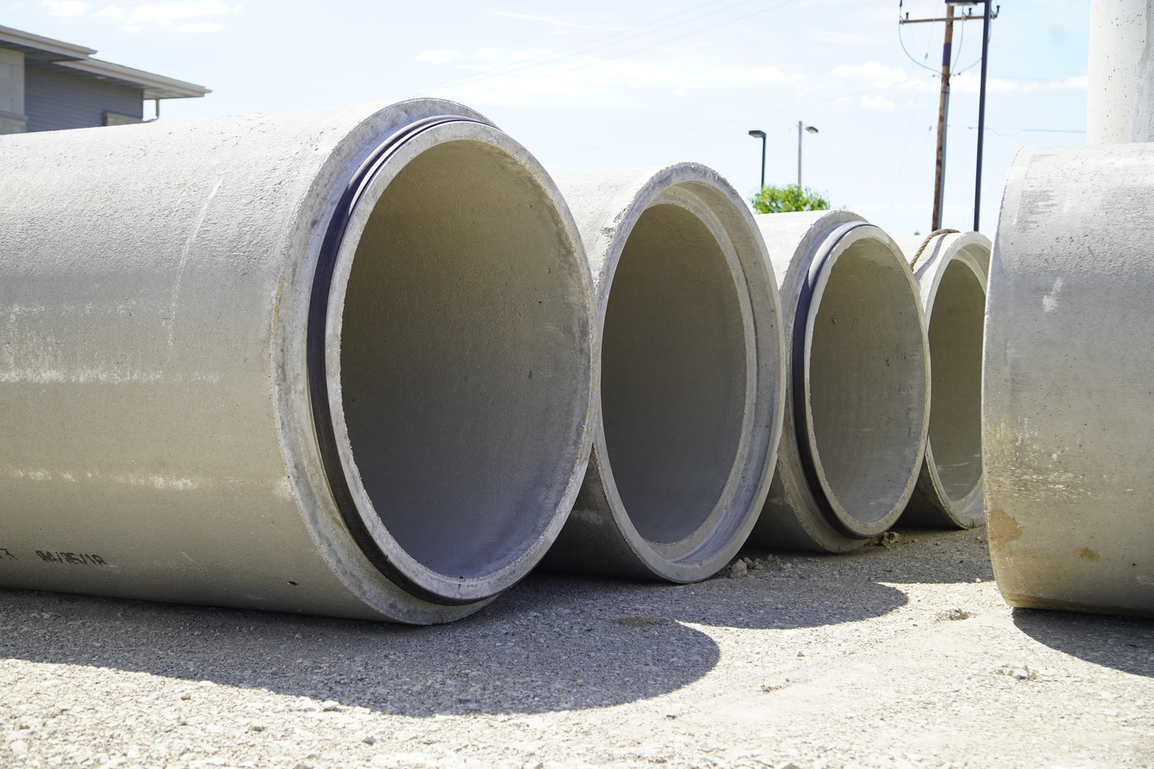
Cherokee County Engineering Department
Stormwater Ordinance Revisions
November 3, 2020

Slide 2

Program Regulatory Background
1972: The National Pollutant Discharge Elimination System (NPDES) is established by the Clean Water Act to address discharges containing pollutants.
1987: Municipal Separate Storm Sewer System (MS4) permitting requirements is established under the NPDES program, requiring certain municipalities to minimize pollutants in stormwater runoff to the maximum extent practicable (MEP).
Under Georgia EPD’s MS4 permit program, communities in regulated areas are required to establish a comprehensive stormwater management program (SWMP) to address stormwater issues.

Slide 3
Program Regulatory Timeline
1993: Phase I permit requirements applied in Georgia to medium and large Ms4’s. (medium - between 100,000 and 250,000 population, and large - greater than 250,000 population)
1995: Cherokee County adopts its first Post-development Stormwater Ordinance.
1999: Federal regulations are adopted to extend the NPDES MS4 permit program to smaller communities; with populations below 100,000 – Phase II communities.
2001: Cherokee County Enhances its SWMP based on Metropolitan North Georgia Water Planning District (MNGWPD) and enters the Phase II Ms4 Program and MNGWPD introduces the Georgia Stormwater Management Manual (GSMM).

Slide 4
Program Regulatory Timeline
2005: Post-development Stormwater Ordinance incorporates stormwater quality requirements, in addition to quantity control.
2007: Post-development Stormwater Ordinance incorporates maintenance agreement requirement on all stormwater management structures and other components of GSMM.
2017: New GSMM manual released that includes runoff reduction component.
2020: Runoff reduction mandatory for Phase II Ms4s, including review of linear infrastructure feasibility.

Slide 5
Cherokee County Development Ordinance Revisions
Section 5 – Stormwater Management (Technical Standards): Last updated in 2005; edits are mainly clarification items and general policy updates to coincide with the Section 6 revisions.
Section 6 – Post Construction Stormwater Management for New Development and Redevelopment: Edits include runoff reduction mandatory for Phase II Ms4’s and review of linear infrastructure feasibility.
  This revision is mandatory to maintain County’s compliance with its EPD Ms4 permit and compliance with the MNGWPD.
  Must be adopted by December 2020.
  Follows the 2019 MNGWPD Model Ordinance – replaces the 2002 version.
  Incorporates additional infiltration requirements with more green infrastructure utilization.
  Requires certain transportation projects to provide stormwater management.

Slide 6
Section 5 – Stormwater Management (Technical Standards)
Section Revision Details
Entirety County Engineer revised to Stormwater Manager.
5.1.A Updates technical standards to Section 6.0.
5.1.J Clarifies maintenance responsibility outside right-of-way.
5.2.C.3.a Add pipe size alternative for small lots.
5.2.C.3.b Add roof drainage stipulation to protect downstream owners.
5.2.C.7 Clarify design requirement.
5.2.C.9 Clarify pipe material type.
5.2.C.9.a Clarify pipe material type for rural subdivisions.
5.2.E Clarify driveway connection requirements.
5.2.F.1.c.5 Add language clarifying downstream analysis requirement.
5.2.F.2.b Clarify local application of GSMM.
5.2.F.3.d.7 Stricter requirement for detention pond fencing.
5.2.F.3.f Update methodologies to be consistent with GSMM.
5.2.F.4.f Clarify location of stormwater facilities to be located outside individual lots.
5.2.F.5.a Clarify access drive requirements for stormwater facilities.
5.2.G Insert Drainage Easement requirements from Section 4.18.C.

Slide 7
Section 6 – Post Construction Stormwater Management for New Development and Redevelopment
Section Description
6.02 Update the GSMM definition to include current edition.
6.02 Adds trout streams definition.
6.04 Designates the Stormwater Manager to administer and implement this Article.
6.06(i), (j), & (k) Adds single-family homes exemption.
6.06(l) Adds Rural Subdivision exemption from stormwater quality/reduction standards as outlined in Section 6.07(d); however, still requires quantity control as outlined in Section 6.07(e-g).
6.07(d)i & ii Specifies December 6, 2020 cut-off date for runoff reduction standard.
6.07(h) Adds trout stream protection standard for temperature elevation.
6.07(i) Adds language clarifying downstream analysis requirements.
6.08(d)xii, xiii, xiv Adds O&M maintenance plan, maintenance access easement language, and bonding requirements.
6.14 Modifies violations and enforcement.
6.16(d), (e) Modifies Inspection and Maintenance Agreements to include/expand ongoing inspection and maintenance.
6.17 Modifies right-of-entry for inspections.
6.18 Modifies specifics in failure to maintain cases.
6.19 Adds the GI/LID (Green Infrastructure/Low Impact Development) requirements.
6.20 Adds Linear Transportation Project requirements.

Slide 8
Section 6 - Summary - Biggest Changes
(as required for compliance with EPD Ms4 Permit)
Runoff Reduction Standard (per MNGWPD Model Ordinance)
Runoff reduction practices shall be sized and designed to retain the first 1.0 inch of rainfall on the site to the maximum extent practicable. Runoff reduction practices are stormwater BMPs used to disconnect impervious and disturbed pervious surfaces from the storm drain system, thereby reducing post-construction stormwater runoff rates, volumes, and pollutant loads.
Encourages a treatment train approach, utilizing several BMP’s (water quality structures) in a basin, instead of a single treatment point in a downstream pond.
Impractical for sites with less than 0.5 inch per hour infiltration rate; this must be documented with the stormwater report submittal.
GI/LID (Green Infrastructure/Low Impact Development) requirements
Linear Transportation Project requirements

Slide 9
Section 6 - Applicability
New development that creates or adds 5,000 square feet or greater of new impervious surface area or that involves land disturbing activity of 1 acre of land or greater;
Redevelopment (excluding routine maintenance and exterior remodeling) that creates, adds, or replaces 5,000 square feet or greater of new impervious surface area or that involves land disturbing activity of one (1) acre or more;
New development and redevelopment if
(i) Such new development or redevelopment is part of a subdivision or other common plan of development, and
(ii) the sum of all associated impervious surface area or land disturbing activities that are being developed as part of such subdivision or other common plan of development meets or exceeds the threshold in (1) and (2) above;
Any commercial or industrial new development or redevelopment, regardless of size, that is a hotspot land use as defined in this Article; and
Linear transportation projects that exceed the threshold in (1) or (2) above.

Slide 10
Section 6 - Exemptions
Land disturbing activity conducted by local, state, authority, or federal agencies, solely to respond to an emergency need to protect life, limb, or property or conduct emergency repairs;
Land disturbing activity that consists solely of cutting a trench for utility work and related pavement replacement;
Land disturbing activity conducted by local, state, authority, or federal agencies, whose sole purpose is to implement stormwater management or environmental restoration;
Repairs to any stormwater management system deemed necessary by the administrator;
Agricultural practices as described O.C.G.A. 12-7-17(5) within areas zoned for these activities with the exception of buildings or permanent structures that exceed the threshold in 6.05 (a) or (b);
Silvicultural land management activities as described O.C.G.A. 12-7-17(6) within areas zoned for these activities with the exception of buildings or permanent structures that exceed the threshold in 6.05 (a) or (b);
Installations or modifications to existing structures solely to implement Americans with Disabilities Act (ADA) requirements, including but not limited to elevator shafts, handicapped access ramps and parking, and enlarged entrances or exits; and
Linear transportation projects being constructed by Cherokee County to the extent the administrator determines that the stormwater management standards may be infeasible to apply, all or in part, for any portion of the linear transportation project. For this exemption to apply, an infeasibility report that is compliant with Cherokee County’s linear feasibility program shall first be submitted to the administrator that contains adequate documentation to support the evaluation for the applicable portion(s) and any resulting infeasibility determination, if any, by the administrator;
Single-family or duplex residential lots platted prior to the adoption of this ordinance, whether or not they are part of a subdivision or phased development project;
Additions or modifications to existing single-family or duplex residential structures;
Individual single-family or duplex residential lots that are not part of a subdivision or phased development project;
  (Consistent with current ordinance and keeping it in - EPD may challenge this exemption)
Rural Subdivisions are exempt from Stormwater Quality/Reduction Standards; however, they are required to provide quantity control to reduce off-site runoff. (EPD may challenge this exemption)

Slide 11
Next Steps
Public hearing to consider revisions to Sections 5 and 6 of Development Regulations –Stormwater Management - December 1, 2020
Introduce revisions to Subdivision Regulations and Sections 3 and 4 of Development Regulations for Rural Subdivisions – December 1, 2020

Slide 12
Questions?
Ben L. Morgan, P.E., CFM – Stormwater Manager blmorgan@cherokeega.com
Geoffrey E. Morton, P.E., Community Development Agency Director gmorton@cherokeega.com

